Slide 1
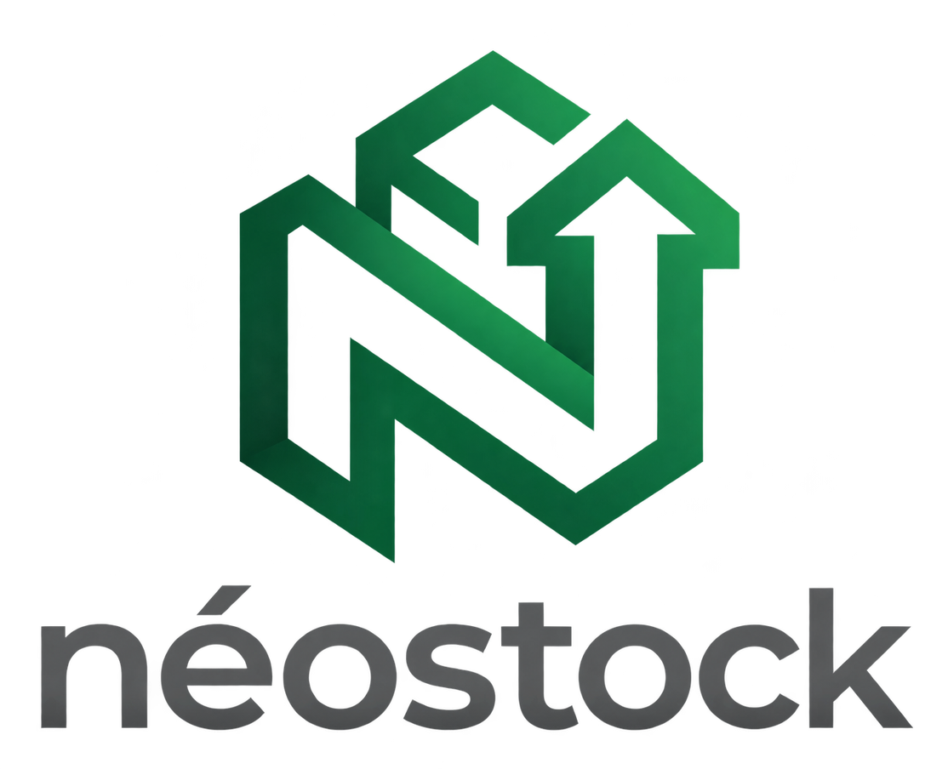
NeoStock
Wael Saadallah
Presented by :
Yosri Rais
Chahine Askri
NeoStock is an AI-powered stock management solution designed to help businesses monitor inventory, analyze sales data, identify slow- and fast-moving products, and receive intelligent recommendations to improve stock management and business decisions.
hackthon-store-dashbord.pages.dev

Slide 2
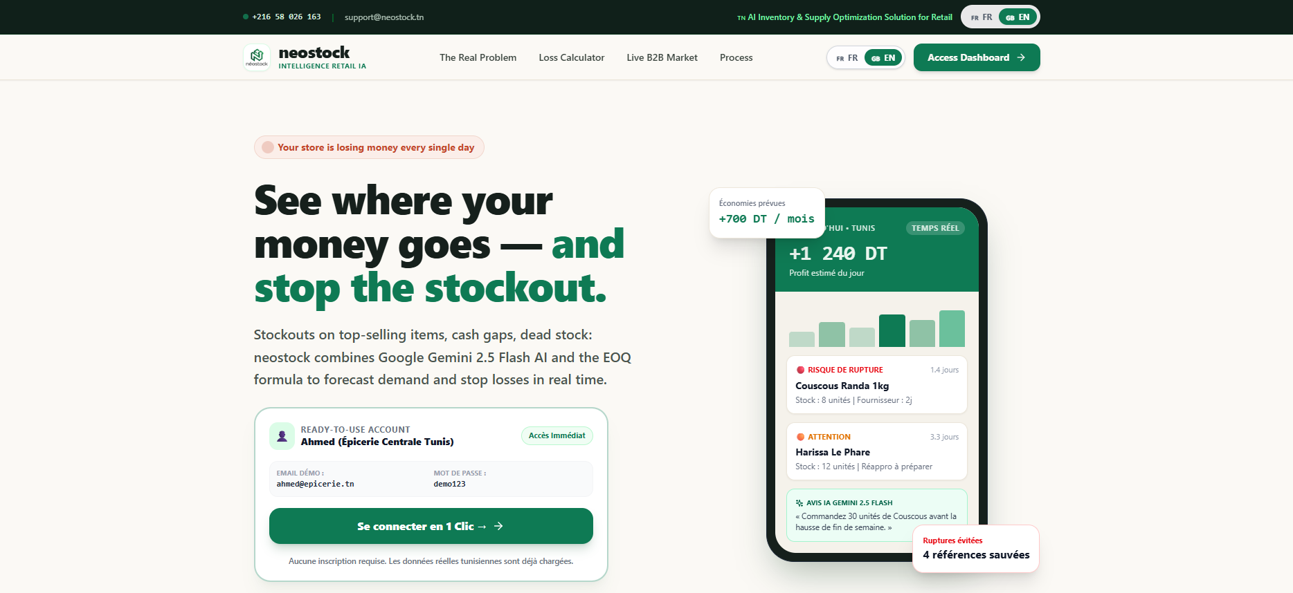
landing page

Slide 3
the main story :
neostock is an AI-powered inventory app built for neighborhood grocery stores in Tunisia.
Small grocers lose money every month because of run-out stock, unsold products, and unfair wholesale prices. neostock solves this by predicting what items to restock and when, so store owners never run out of customer favorites or waste money on dead inventory.
Key Features:
Smart Restock Alerts: Automatically tracks inventory, seasonal demand, and local market trends to alert store owners before products run out.
1-Click WhatsApp Orders: Grocers can reorder inventory instantly through WhatsApp.
Group-Buying Terminal: Allows nearby store owners to pool their orders together, giving small grocers up to 20% direct factory discounts usually reserved for big supermarkets.

Slide 4
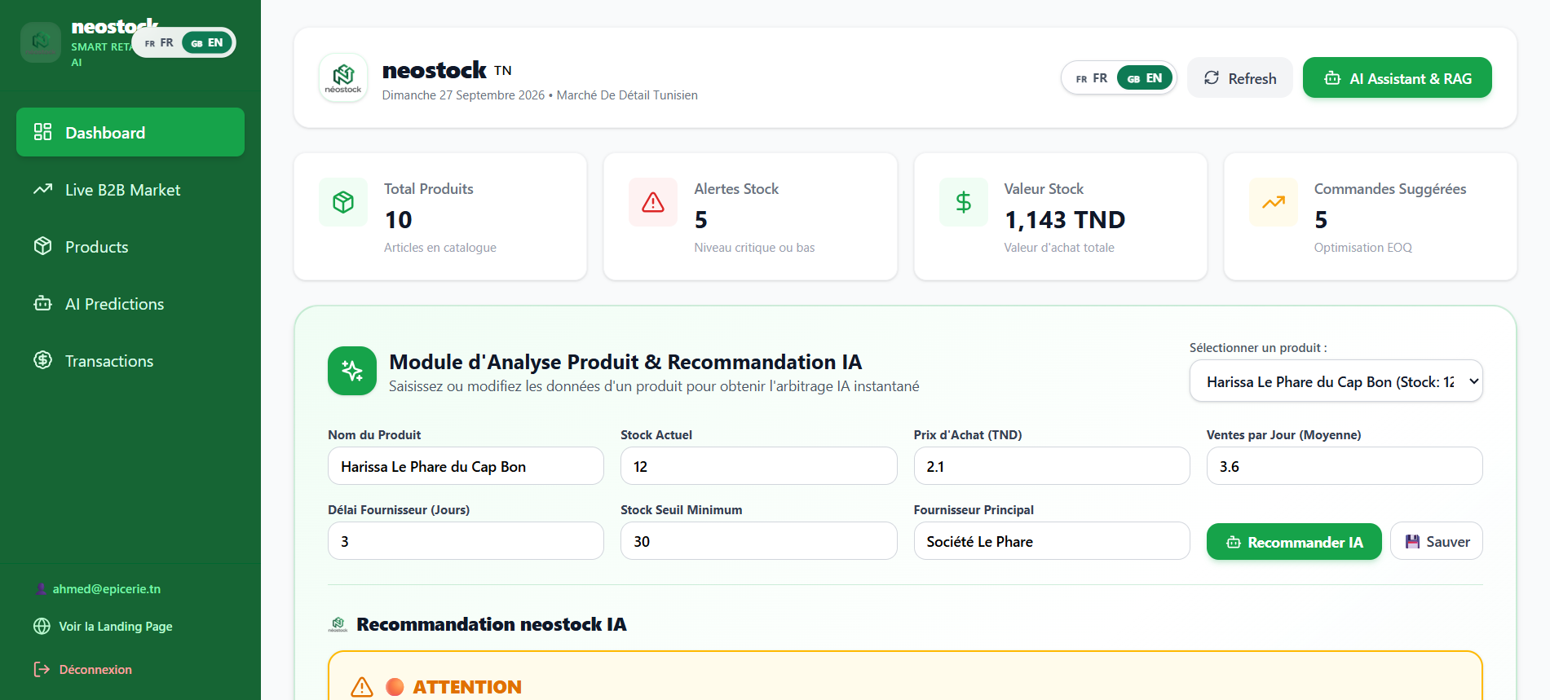
dashboard page
all the stats needed with AI review

Slide 5
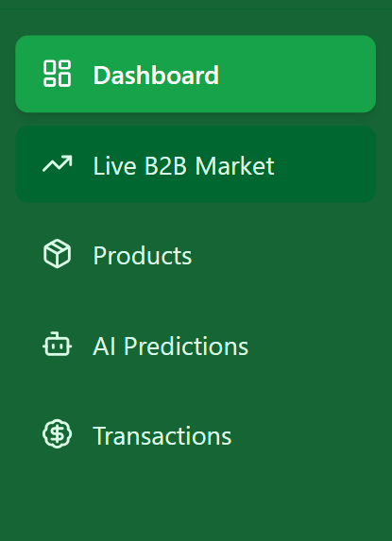

dashboard page
the dashboard where you can see all the videos
B2B Market place with all the tunisien big transcations
You’re product manager
AI chatbot with all the stats and the graph
transactions list

Slide 6
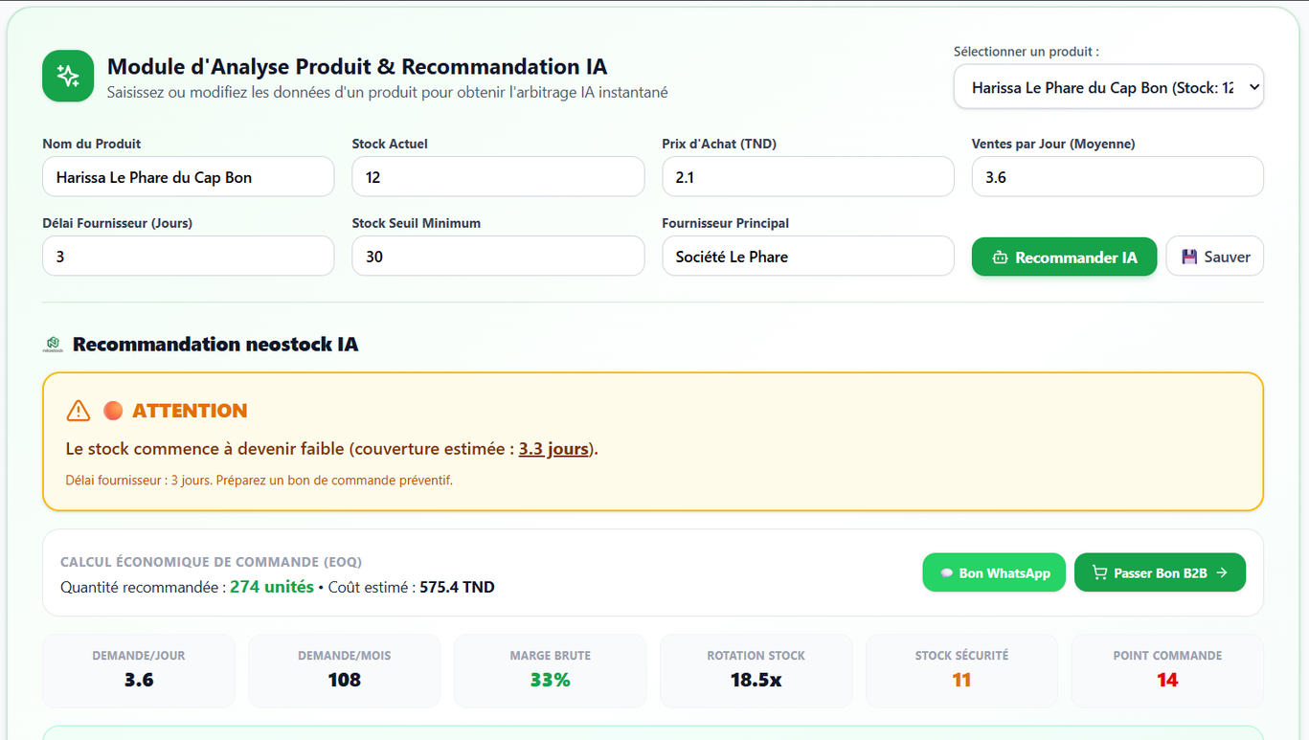
dashboard page
in the dashboard page you can have a ai review for your current bussiness situation

Slide 7
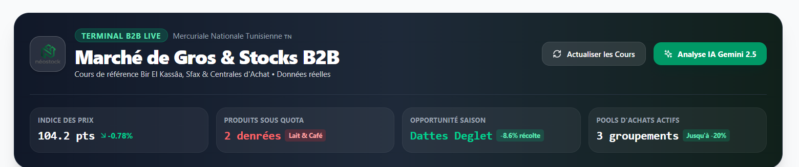
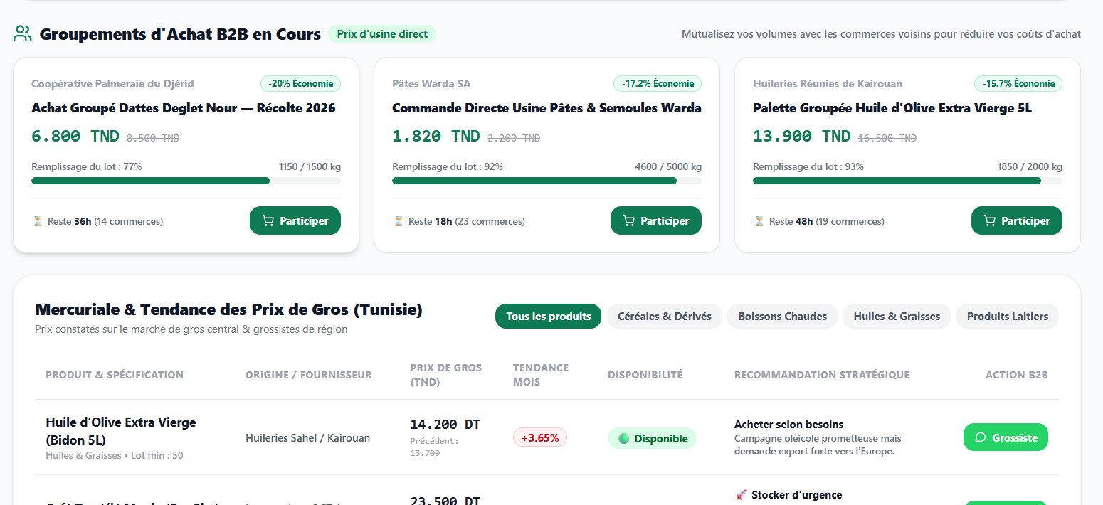
dashboard page
B2B section with all the contact of big tunisian sellers and latest offers

Slide 8
B2B
B2B section with all the contact of big tunisian sellers and latest offers

Slide 9
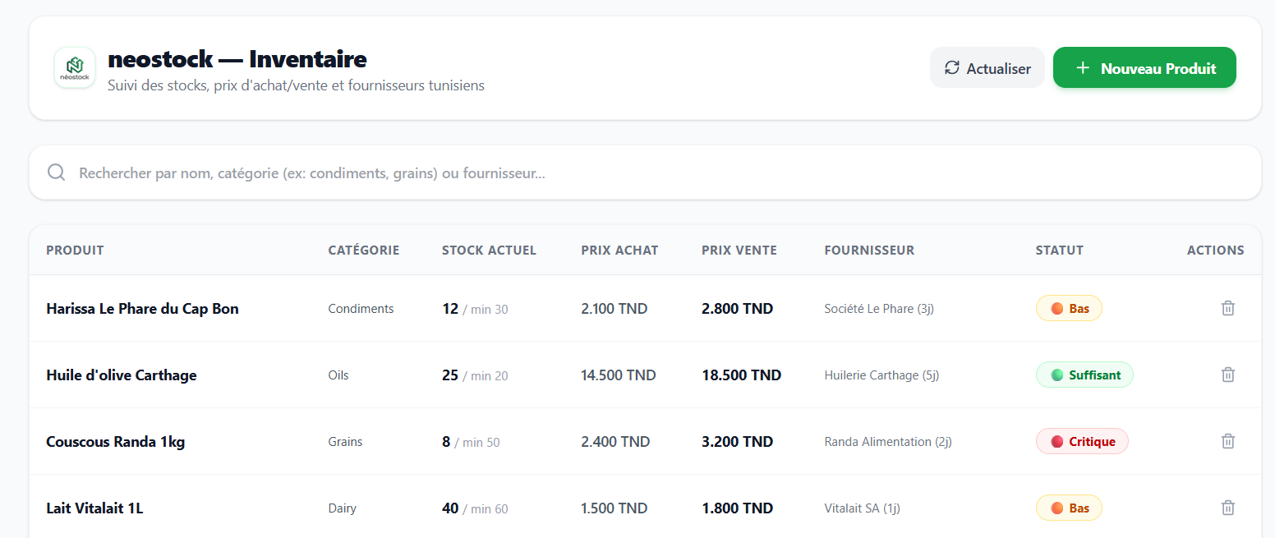
neostack products section
here you can add or delete any product with a fast tatus

Slide 10
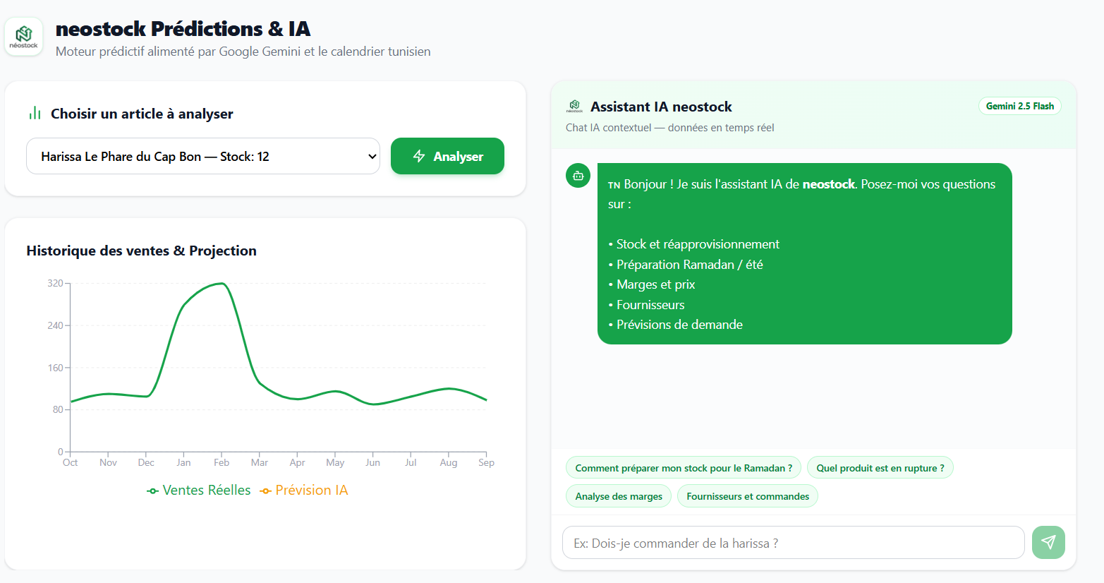
AI chat with chart

Slide 11
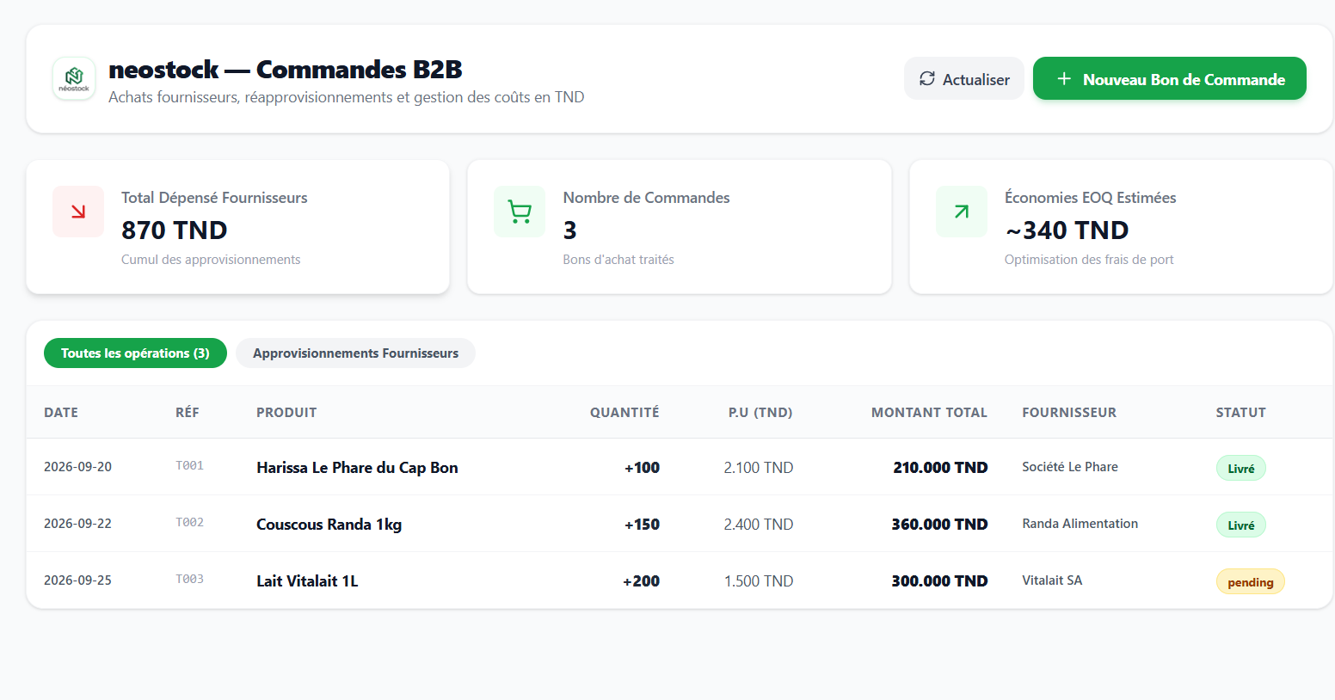
all of your transactoins within the bussiness

Slide 12
Presentation
How NeoStock Works
From Raw Data to Smart Decisions
NeoStock follows a simple process to transform business data into useful actions.
Step 1 — Data Collection
The system uses information about products, inventory, and sales performance as the foundation for its analysis.
Step 2 — Data Analysis
NeoStock processes the available information to identify sales trends, product performance, and changes in inventory.
Step 3 — Problem Detection
The system can identify situations such as products with low sales, products remaining in stock for a long period, or products showing strong demand.
Step 4 — AI Recommendations
The AI assistant uses the available insights to suggest possible actions that the manager can consider.
Step 5 — Business Action
The manager can use these insights to make informed decisions about promotions, bundles, inventory management, or other business strategies.

Slide 13
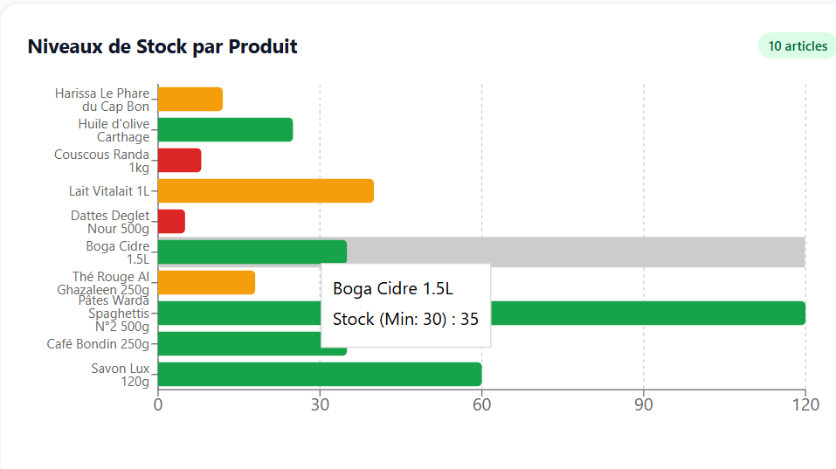
Data
Analysis
Turning Sales Data Into Useful Insights
Raw business data is not always easy to understand. NeoStock transforms this information into visual insights that allow managers to recognize important patterns more quickly.
Sales Trends
Visual charts help managers understand how sales change over time and identify increases or decreases in product performance.
Product Performance
Products can be compared according to their sales performance, helping managers distinguish between successful and underperforming products.
Slow-Moving Products
NeoStock can help identify products that are not selling as expected and may remain in inventory for too long.
Fast-Moving Products
Products with strong sales performance can be identified, helping managers pay attention to demand and inventory levels.
Why this matters
Instead of asking:
“What is happening with our stock?”
The manager can move toward:
“Why is it happening, and what should we consider doing?”

Slide 14
thank you
project makers :
chahine askri : product and strategy manager
wael saadallah : presentation and video voice editor
yousri rais : whole app developer & video editor

